Slide 1

Text Mining

Slide 2
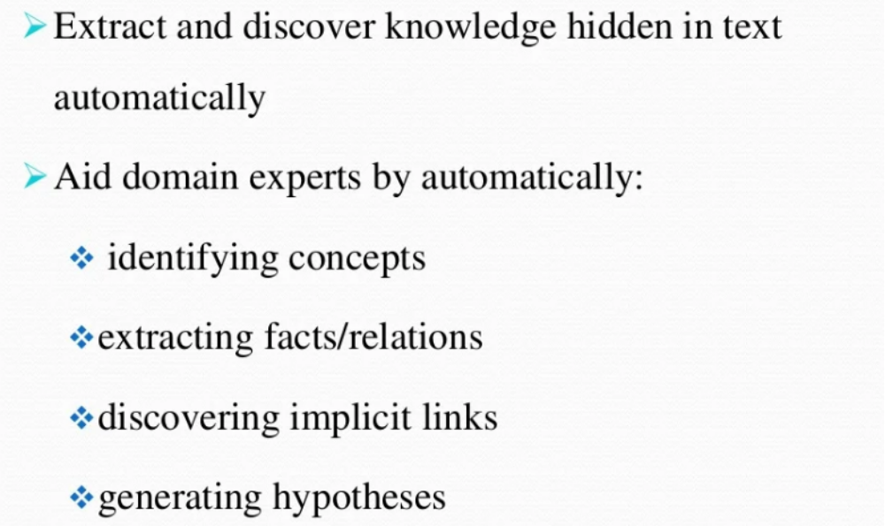
TEXT MINING

Slide 3
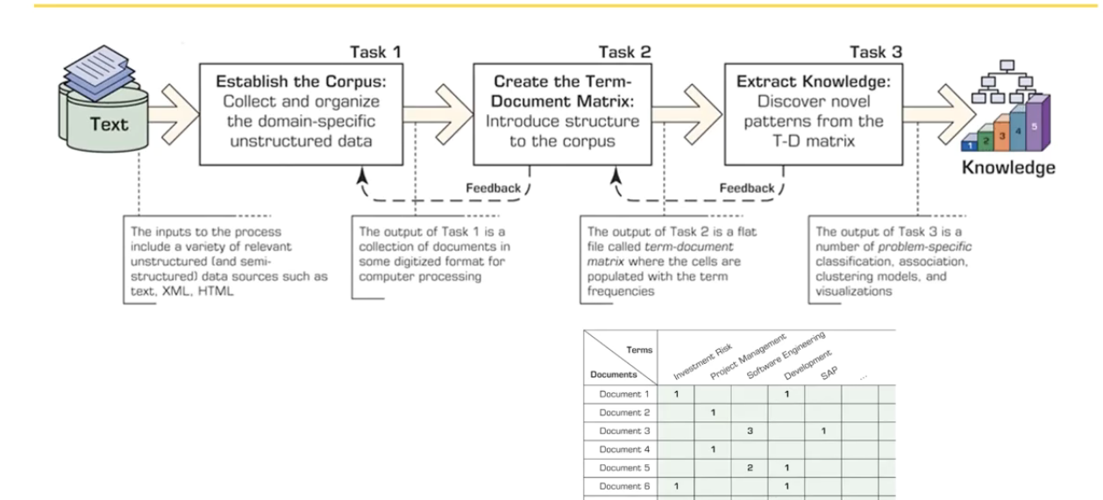
Text Mining Process

Slide 4

Text Mining
Document Similarity…

Slide 5
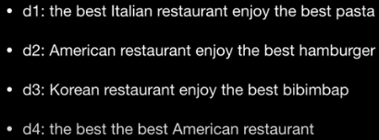
Document Similarity

Slide 6
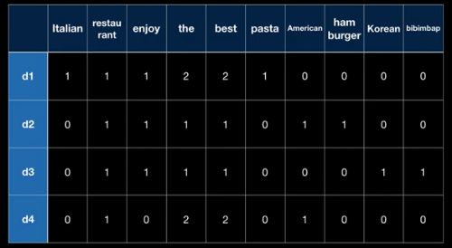

Bag of Words

Slide 7
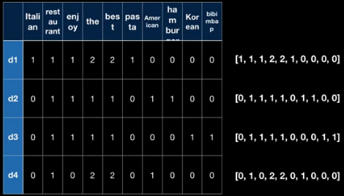
Bag of Words – Doc Similarity

Slide 8

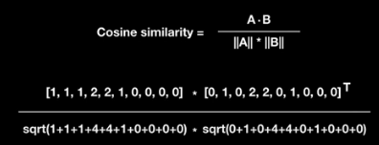

Bag of Words – Cosine Similarity

Slide 9
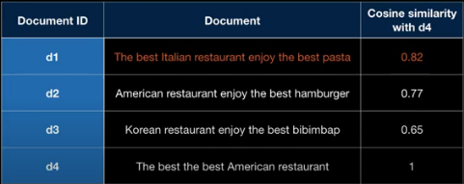
Cosine Similarity among (Di,D4)

Slide 10
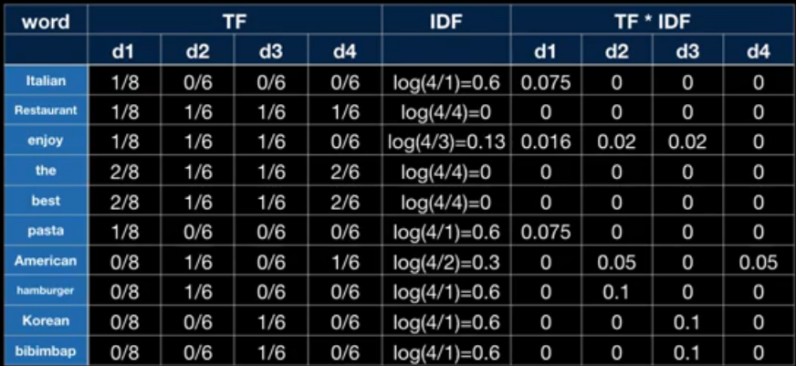
TF-Term Frequency
IDF-Inverse Document Frequency

Slide 11
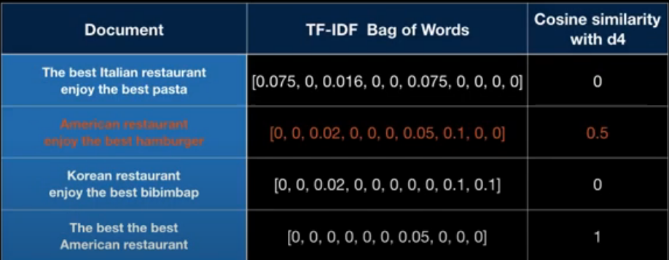
COSIM(TFIDF(Di),TFIDF(D4))

Slide 12


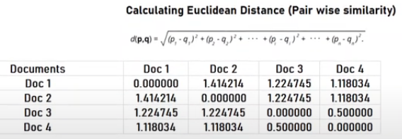

Slide 13



Slide 14

Packages in R

Slide 15

Pre-processing

Slide 16


Cosine Similarity

Slide 17

Similarity Matrix

Slide 18
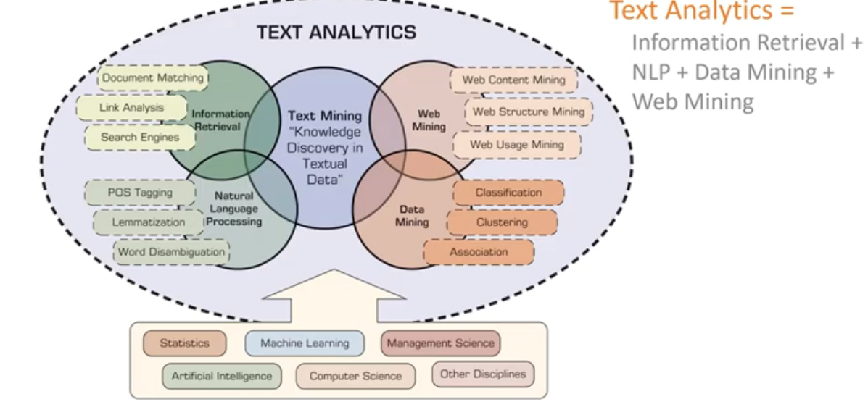
Text Mining vs Analytics

